Slide 1
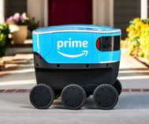
The Internet CSE 120 Winter 2019
Instructor: Teaching Assistants:
Justin Hsia Ann Shan, Eunia Lee, Pei Lee Yap, Sam Wolfson, Travis McGaha
Amazon Starts Testing ‘Scout’ Delivery Robots Near Seattle
“Amazon.com Inc. will use robots to deliver packages in the suburbs north of Seattle, its latest experiment to automate the last-mile of delivery that’s a labor-intensive and costly component of buying products online.
“Using robots to make deliveries outside on city streets will be much more challenging than most current common uses, such as moving items around in warehouses, hospitals and hotels that are well-lit and have level floors. Outside, robots encounter extreme weather conditions, steep inclines, curbs and other problems that present significant engineering challenges.”
https://www.bloomberg.com/amp/news/articles/2019-01-23/ amazon-starts-testing-scout-delivery-robots-near-seattle

Slide 2
Administrivia
Assignments:
Animal Functions [submit] due Monday (1/28)
Should start adding projects to your Portfolio ASAP

Slide 3
Outline
Networks
Growth of the Internet
Sending Information
Encryption

Slide 4
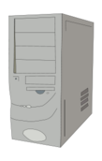
Communication Channels
We often transmit sequences of bits between computers – why?
Only capability we need because of binary encoding!
Via wire: Ethernet
Via wireless: WiFi, 3G/4G/5G, Bluetooth
A network is a group of computing devices connected together, either by wire or wirelessly
Notes:
Access more information and software than is stored locally.
Help users communicate & exchange information.
Perform other remote services.

Slide 5

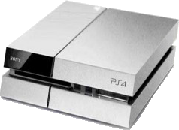
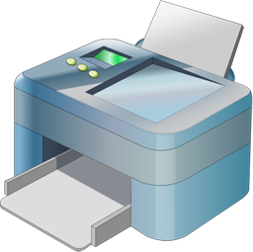
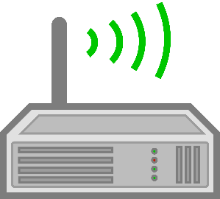
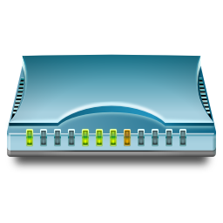
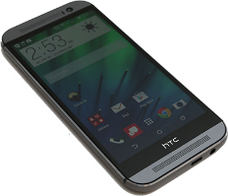
Example: Home Network
The network at my house:
Not counting the outside world

Slide 6

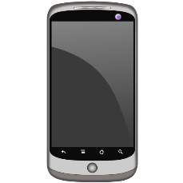


Example: Cellular Network

Slide 7

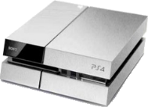


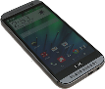



Internetworking
If you connect two networks, you still have a network
Sometimes called an “internetwork”
The largest network of networks on the planet is usually called “The Internet”

Slide 8
The Interwebs?
The Internet: All of the hardware and data associated with the network of all networks (wires, fibers, switches, routers, servers, files, etc.)
The World Wide Web: The system used to access the Internet (data transmission via browsers, web servers, web services, etc.)

Slide 9
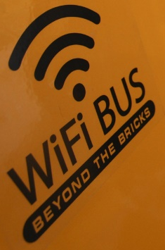

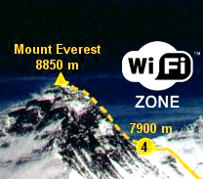
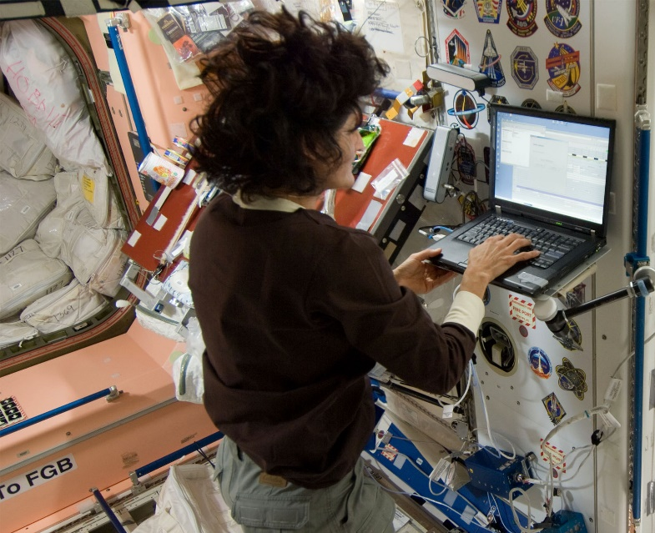
Internet Accessibility
Can now get Internet almost anywhere:
On a bus
On a plane
On a mountain
In outer space
StarTribune
united.com
Slash Gear
NASA

Slide 10
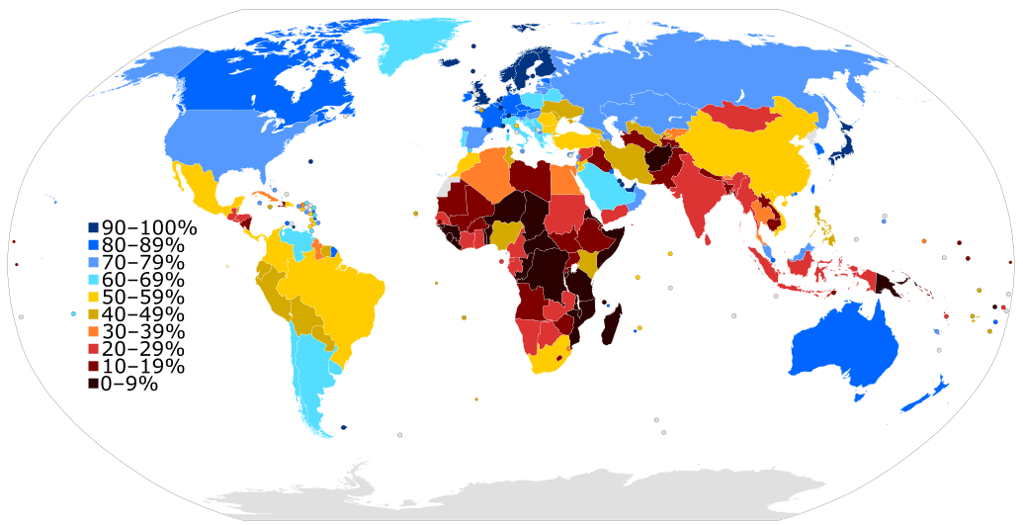
The Internet Today
Internet Usage as a Percentage of Population (2015)
By Jeff Ogden (W163) - Own work, based on figures from the Wikipedia: List of countries by number of Internet users article in the English Wikipedia, which is in turn based on figures from the International Telecommunications Union (ITU) for 2010 (updated to use figures for 2012 on 28 June 2013). The source code of this SVG is valid. This vector image was created with a text editor. This vector image includes elements that have been taken or adapted from this: BlankMap-World6.svg., CC BY-SA 3.0, https://commons.wikimedia.org/w/index.php?curid=19202338

Slide 11
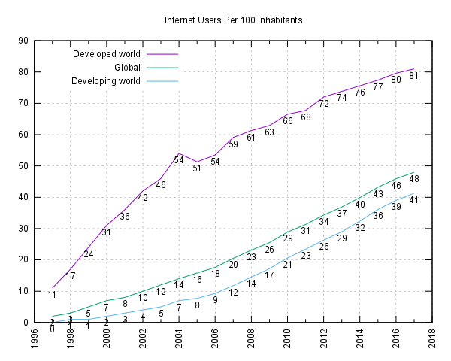
The Internet Today
Internet users per 100 inhabitants
By Jeff Ogden (W163) and Jim Scarborough (Ke4roh) - Own work, CC BY-SA 3.0, https://commons.wikimedia.org/w/index.php?curid=18972898
Notes:
Information and Communication Technology for Development (ICTD) Lab: http://ictd.cs.washington.edu/

Slide 12
Outline
Networks
Growth of the Internet
Sending Information
Encryption
Data Storage

Slide 13
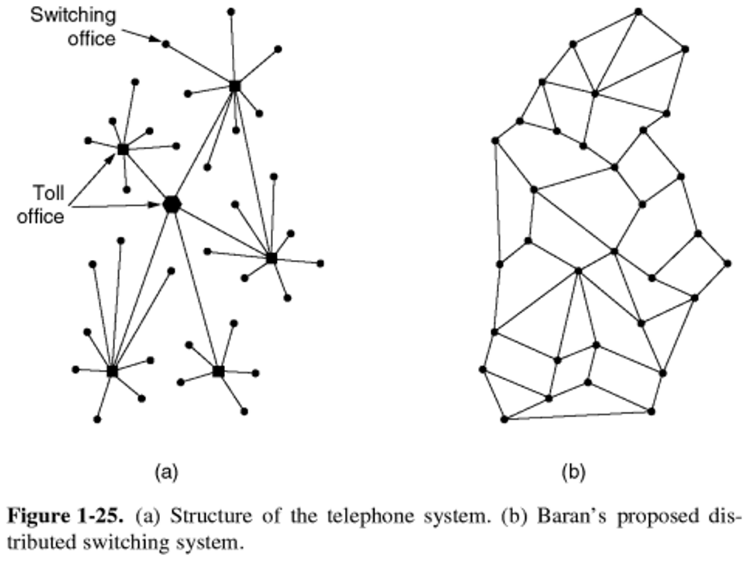
The DoD and Computer Networks
The Department of Defense (DoD) observed that central offices made communication network vulnerable to attack
1950s – The Cold War
Can we build a more robust, decentralized system?
Figure from Computer Networks by Tanenbaum and Wetherall

Slide 14
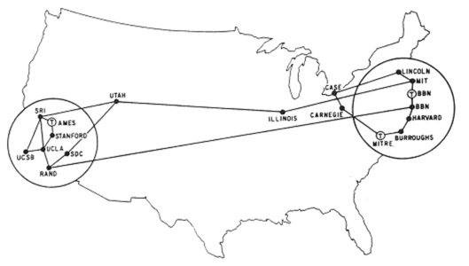
ARPANET
First 4 nodes of ARPANET connected in 1969
Stanford, UC Los Angeles, UC Santa Barbara, Utah
By Sept. 1971, there were 18 nodes across the US
Grew exponentially from there for a long, long time
ARPANET superseded by NSFNET in ‘86, Internet in ‘91

Slide 15
Growth of the Internet
The major point in building networks is agreement
The only way to get seamless integration
Open standards/protocols enabled rapid growth
Internet Engineering Task Force (IETF)
Request for Comments (RFC)
World Wide Web Consortium (W3C)
HTML
International Standards Organization (ISO)
JPEG, MPEG
Institute of Electrical and Electronics Engineers (IEEE)
WiFi

Slide 16
Outline
Networks
Growth of the Internet
Sending Information
Encryption
Data Storage

Slide 17
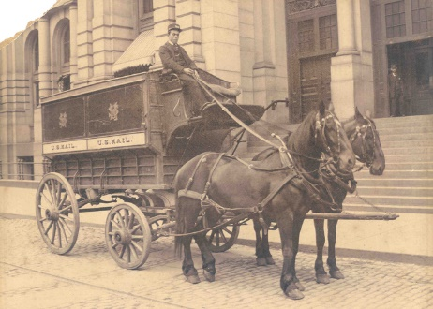
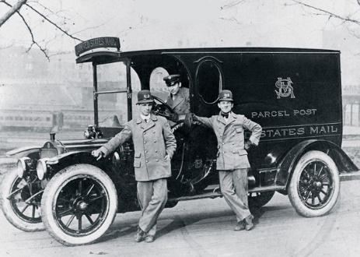
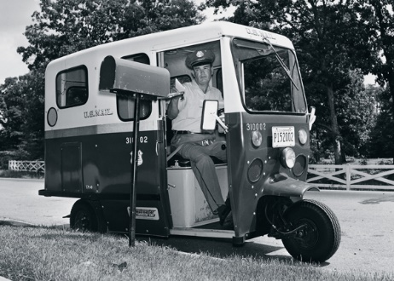
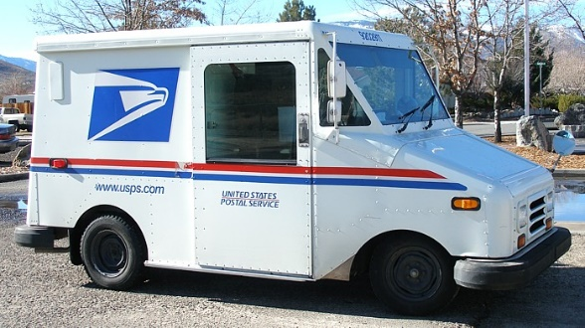
Analogy: Mailing a Letter
Want to send a letter to my parents
Write their unique address on the envelope
Stamp it
Drop it in a mailbox
I rely on the abstraction that the US Postal Service will magically deliver the letter to the specified address
1895
1913
1964
present

Slide 18
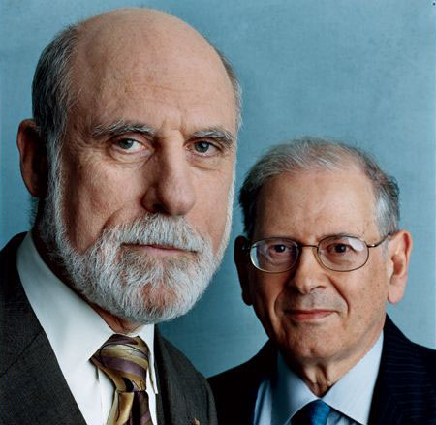
IP Addresses
In 1974, Vint Cerf and Bob Kahn completed the specifications for the Internet Protocol (IP)
Every device given a unique 32-bit address (IP address)
Large entities (e.g. companies, universities) can keep an IP address forever and allocate to physical machines as desired
For home machines, IP address is typically not permanent
Address is used to get information to the right computer on a network
Check your IP address: https://www.whatismyip.com
Image: Archeologia Informatica

Slide 19
The Internet Protocol
Internet Protocol (IP) routes data across multiple networks
Every computer has a unique IP address
Individual networks are connected by routers that span networks
128.95.10.55
128.95.10.72
128.95.10.95
host
host
host
128.95.10.1
ethernet
router
128.95.4.1
ethernet
host
host
host
128.95.4.3
128.95.4.10
128.95.4.12

Slide 20
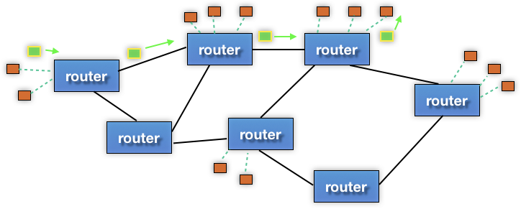
Internet Communication
Break the information into lots of tiny pieces called packets, about 1500 bytes long each
Packets are sent through the network (passing through many different machines) to their destination
The packets are reassembled on the other side
destination
source

Slide 21
Internet Communication
Packets must contain:
Destination address
Sequence/piece number
Content/data
addr | # | data
destination
source

Slide 22
Internet Communication
Advantages:
Packets can take separate routes
Can even originate from different locations
If packet is lost, only have to resend small amount of info
addr | # | data
destination
source

Slide 23
Internet Communication
Disadvantages:
Extra transmission data
e.g. same destination address for many packets
Every computer along a packet’s path sees the content of the packet
addr | # | data
destination
source

Slide 24
Domain Name System
Remembering IP addresses would be brutal for humans
Instead we use domain names, which are human-readable and more flexible
e.g. cs.washington.edu instead of 128.208.3.88
Computers find IP address for a domain name from the domain name system (DNS)
Another computer that acts as an IP address book
Your computer does need to know the IP address of the DNS server
DNS is an automatic directory search – it’s huge!

Slide 25
Outline
Networks
Growth of the Internet
Sending Information
Encryption
Data Storage
The following slides are curtesy of Prof. Franzi Roesner and Eric Zeng from the Security and Privacy Research Lab at UW CSE.

Slide 26
Something You May Not Have Noticed
Your communication with Google is encrypted
You know that you’re actually talking to Google (probably)
What does this actually mean???

Slide 27
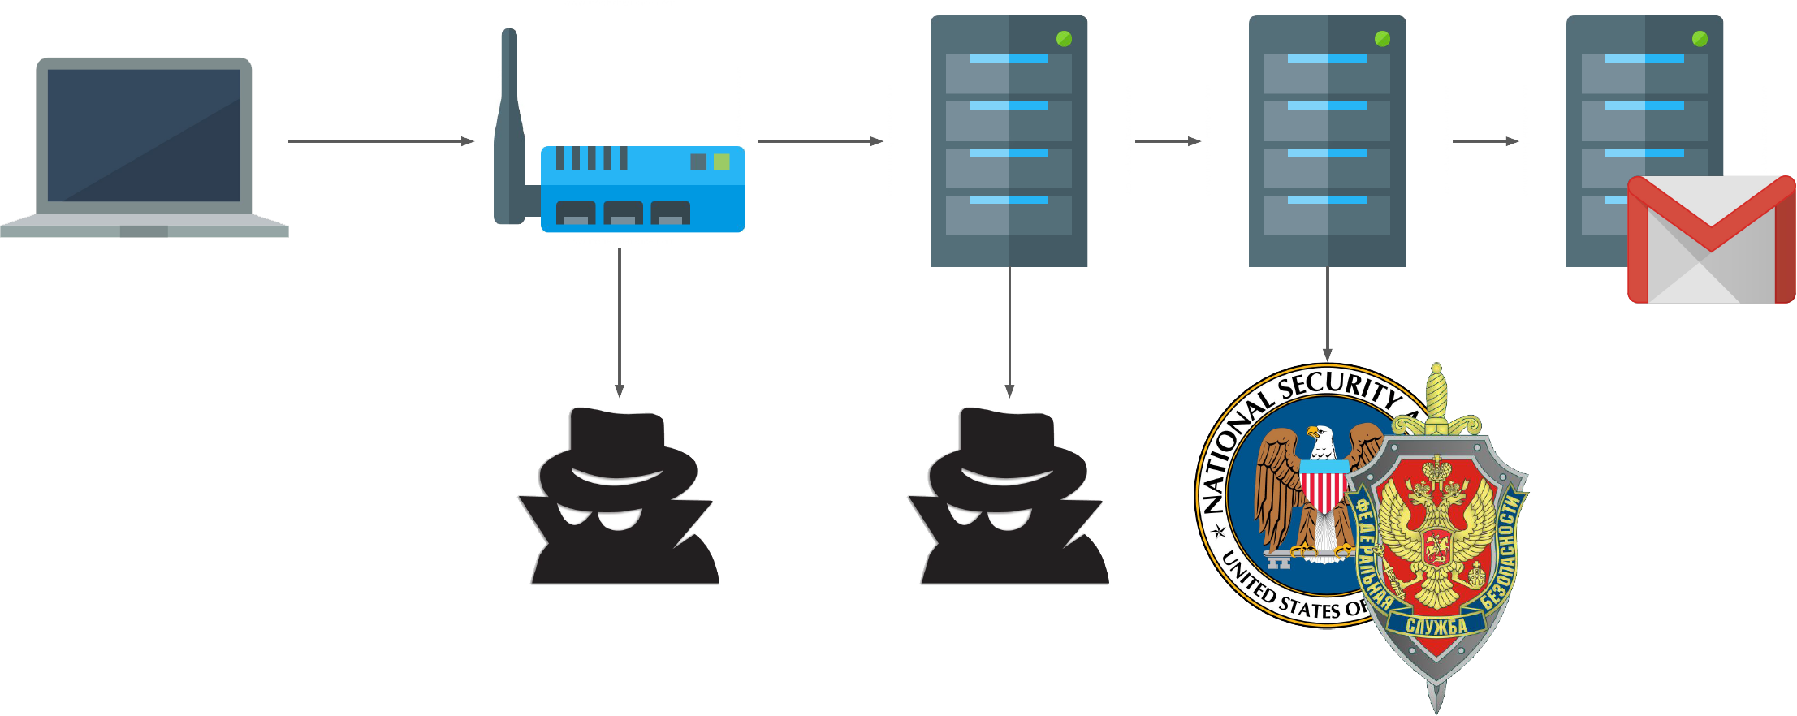
Why Encryption?

Slide 28
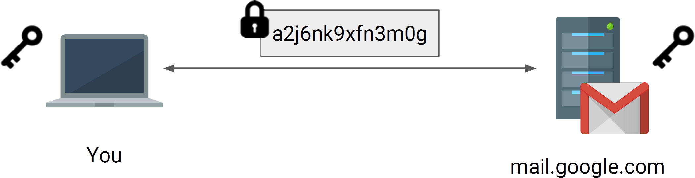
Symmetric-Key Encryption
Use a secret key to both encrypt and decrypt the message/data
Both parties must have access to the secret key
How do we exchange keys???

Slide 29
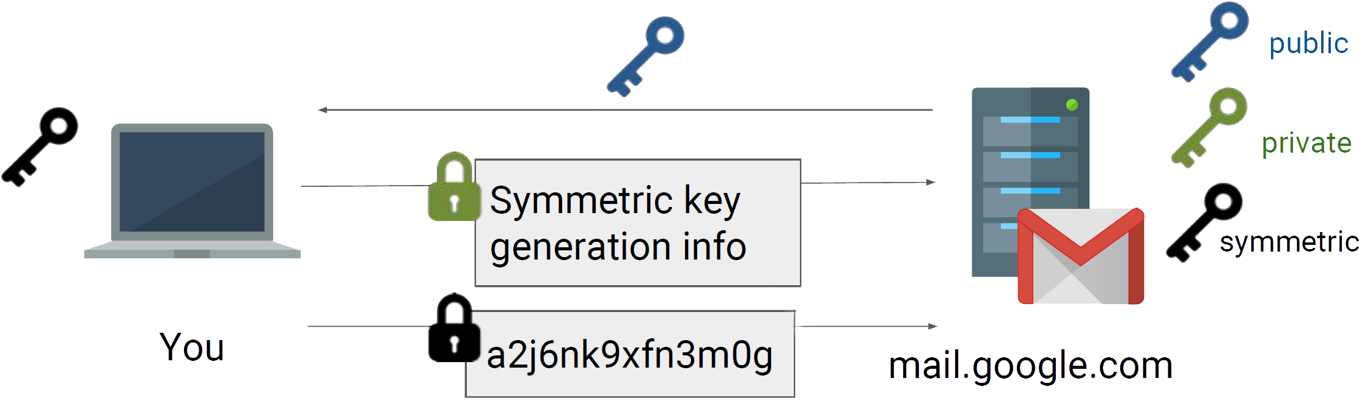
Asymmetric Encryption
How do we know that this key is really from Google???
Use public key encryption to bootstrap symmetric key
Much slower to do public key encryption than symmetric

Slide 30
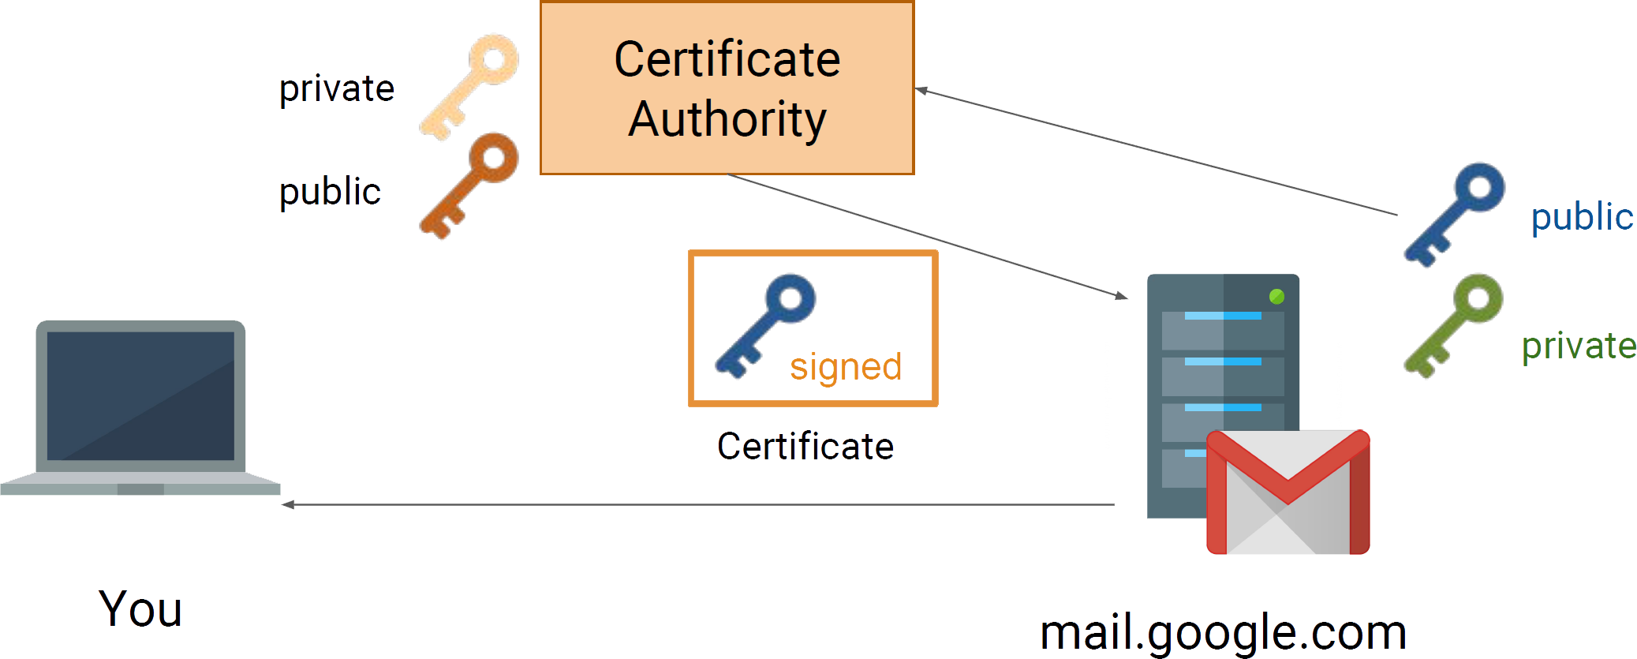
Certificate Authorities
Your browser knows some trusted authorities!

Slide 31
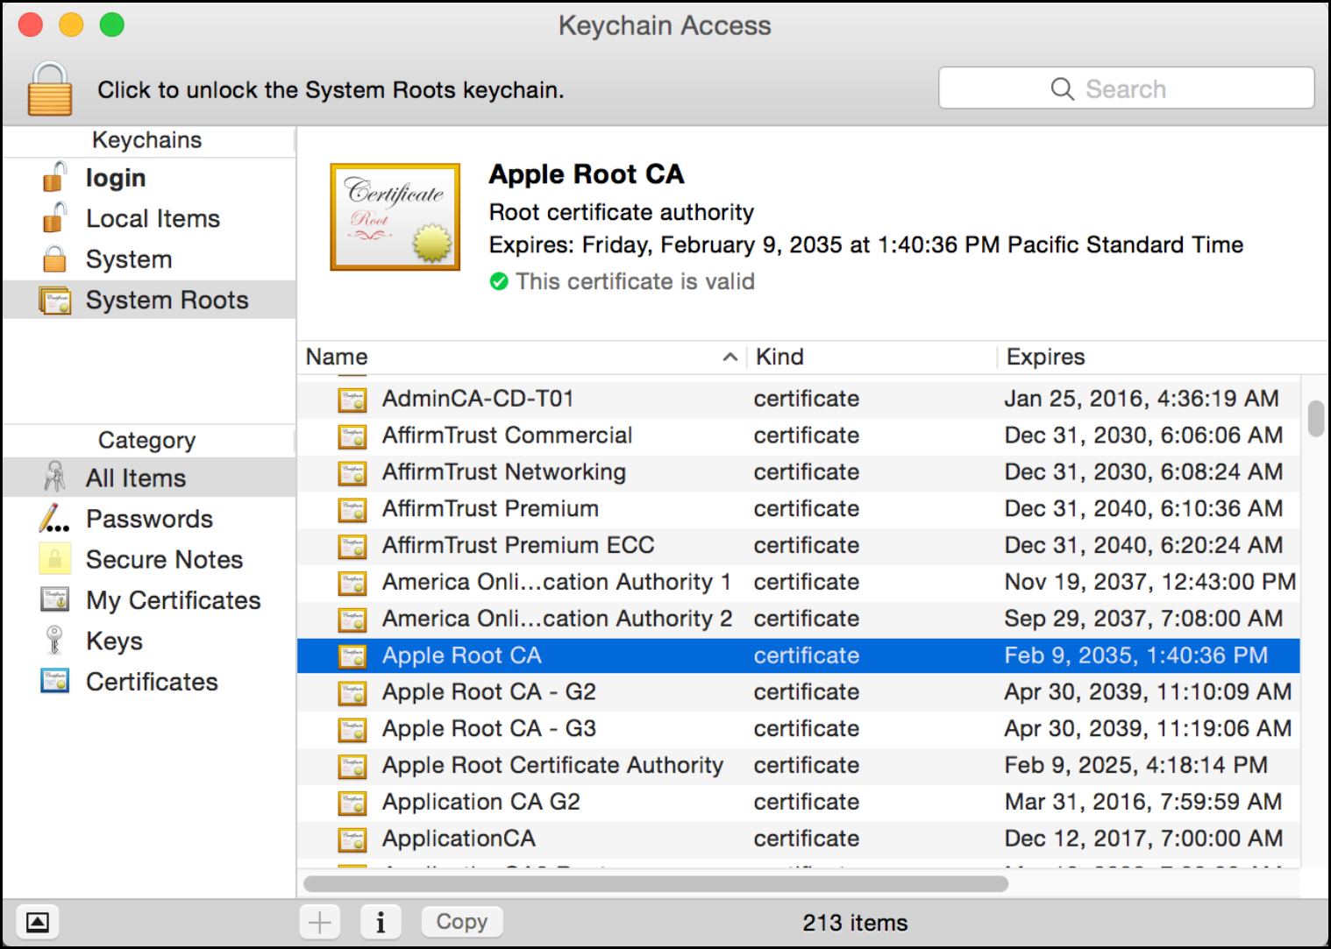
Trusted(?) Certificate Authorities

Slide 32
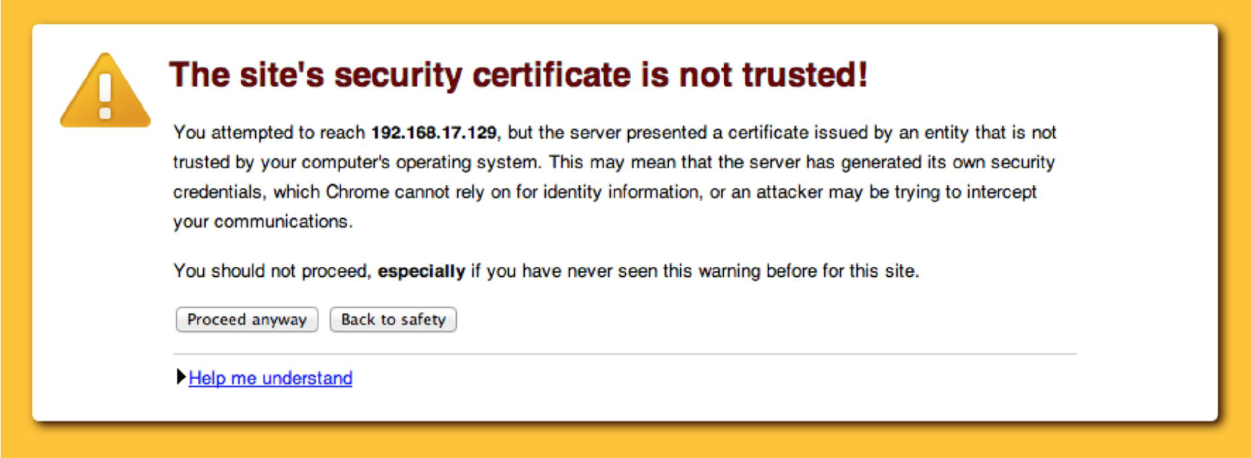
What If the Certificate is Bad?

Slide 33
Summary
A network is a group of computing devices connected together, either by wire or wirelessly
The Internet is the largest network of networks
The Internet grew rapidly
Highly fault-tolerant due to decentralization
Growth aided by open standards (agreement)
Data is passed between computing devices in small pieces called packets
The domain name system translates from domain names to IP addresses in order to reach a specific device
Encryption helps us secure data transmissions between devices

